Slide 1
casos unit testing

Slide 2
Overview
We want to check the basic polynomial operations of casos/PS work
Test can be used to assert two things:
Functional verification
Performance (e.g. computation time) to find bottlenecks or for further code improvement
Many polynomials (different degrees, different no. of indeterminates) need to assure proper testing
→ We need reference values to compare with!

Slide 3
Overall Testing Procedure
Separate script to generate random polynomials using sosopt → Store in .mat file
Separate script to generate random polynomials using casos using same coefficients → Store in .mat file
Establish test script for sosopt to generate reference values (polynomials) → Store in .mat file
Establish test script for casos to generate reference values (polynomials) → Compare casos and sosopt values (polynomials)

Slide 4
Test Framework
Matlab Provides testing environments
Class based seems to be the cleanest way
Proposal:
Scripts function of polynomial generation and tests (have short code)
Testing class that evaluates tests etc.
Can be easily extended

Slide 5
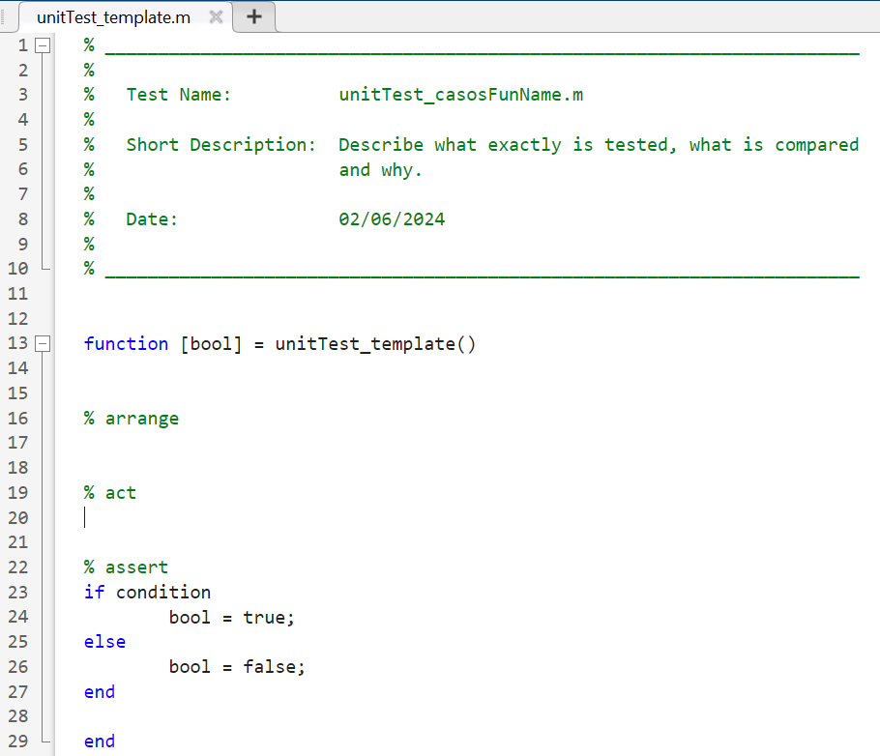
Unit test set up
Use of AAA-scheme:
Arrange: load data and setup test (load .mat file data and other initialization)
Act: perform/execute actual function (execute casos function)
Assert: compare to reference value (come from sosopt)
Code Listing (unitTest_template.m)

